Slide 1
SQA
Presentation
TEAM 3

Slide 2
1.0 Introduction
The Software Quality Assurance (SQA) Plan outlines the processes, standards, and activities designed to ensure the quality of the VR Wheelchair Ping Pong software. It establishes the framework for managing and delivering a reliable, user-friendly, and high-performing product, aligned with the project's objectives and constraints.
1.1 Scope and intent of SQA activities
The SQA Plan focuses on ensuring that the software meets specified requirements, adheres to industry best practices, and satisfies user needs. The key objectives include:
Verification: Ensuring that the software is built correctly, adhering to design specifications and functional requirements.
Validation: Confirming that the software meets user expectations and achieves its intended purpose.
Compliance: Monitoring adherence to defined standards, including coding guidelines, testing protocols, and project milestones.
Risk Mitigation: Identifying and resolving quality risks early in the development process to minimize costly issues later.
Continuous Improvement: Facilitating feedback loops to improve processes and deliverables iteratively.

Slide 3
1.0 Introduction Continued
Organizational responsibilities include:
Development Team: Implementing quality-focused coding practices and unit testing.
QA Engineers: Conducting system-level testing, identifying bugs, and ensuring resolution.
Project Manager: Ensuring quality milestones are met and resources are allocated for quality efforts.
1.2 SQA organizational role
The SQA group operates as an independent unit within the project organization to maintain impartiality in quality assessments. It is positioned parallel to the software engineering teams, reporting directly to the Project Manager to ensure transparency and alignment with project goals.
Key interactions between the SQA group and the software engineering teams include:
Collaboration: Regularly reviewing deliverables, sharing quality metrics, and discussing defect resolutions.
Audits: Conducting process and product audits to verify compliance with established standards.
Feedback Loops: Providing useful feedback to the development team for improvements in code quality and adherence to requirements.
Testing Integration: Working closely with the development team to design and execute effective test cases for all project phases.

Slide 4
2.0 SQA Tasks
This section details all important SQA tasks and assigns responsibility for each. Note that many SQA tasks are performed by software team members. Others may be performed by SQA specialists.
2.1 Task Overview
This section outlines the key SQA tasks required to ensure the quality and reliability of the software. Each task is described, and responsibility is assigned.
2.1.1 Description of SQA task m
Task 1: Code Reviews
Description: Perform detailed reviews of the codebase to identify defects, ensure compliance with coding standards, and validate proper implementation of requirements.
Responsibility: Software development team and QA engineers.
Task 2: Unit Testing
Description: Write and execute unit tests to validate the functionality of individual components/modules of the software.
Responsibility: Software developers.
Task 3: Integration Testing
Description: Test the interactions between software modules to ensure seamless integration and proper communication.
Responsibility: QA engineers and development team.

Slide 5
2.0 SQA Tasks Continued
Task 4: Performance Testing
Description: Conduct performance tests to measure system response times, scalability, and resource usage under various conditions.
Responsibility: QA engineers.
Task 5: User Acceptance Testing (UAT)
Description: Facilitate testing with end-users to verify that the software meets user expectations and real-world scenario Responsibility: QA engineers and end-users.
2.1.2 Work products and documentation
Code Reviews: Code review logs, defect reports, and adherence matrices for coding standards.
Unit Testing: Unit test cases, test results, and coverage reports.
Integration Testing: Integration test plans, test results, and issue logs.
Performance Testing: Performance benchmarks, load test reports, and resource utilization logs.
User Acceptance Testing (UAT): UAT feedback, issue logs, and final approval documentation.
2.2 Standards, Practices and Conventions (SPC)
The following standards, practices, and conventions will govern the software engineering work:
Coding Standards: Use industry-standard guidelines for clean, maintainable, and consistent code (e.g., Unity C# conventions).
Testing Practices: Adopt a test-driven development (TDD) approach where feasible.
Version Control: Utilize Git for version control, with a standardized branching strategy (e.g., GitFlow/GitHub). Documentation Standards: Ensure all documents adhere to the Software Requirements Specification format and maintain consistent formatting for readability.
Issue Tracking: Use an issue-tracking system (e.g., Hive) to document, track, and resolve defects.

Slide 6
2.0 SQA Tasks Continued
2.3 SQA Resources
The following resources are required to perform SQA tasks:
People:
QA Engineers
Software Developers
Project Manager
End-users for UAT
Hardware:
Test servers for performance and integration testing.
VR hardware for user testing.
Software:
Testing frameworks (e.g., NUnit for Unity).
Version control tools (e.g., Git).
Continuous integration/continuous deployment (CI/CD) tools (e.g., GitHub).
Tools:
Debugging tools (e.g., Visual Studio Debugger).
Code analysis tools (e.g., Roslyn Analyzers).
Performance testing tools (e.g., Unity Profiler, Apache JMeter).
Collaboration platforms (e.g., Slack).

Slide 7
3.0 Reviews and Audits
Description: Formal Technical Reviews (FTRs) should follow a structured process:
Review objectives are clearly defined.
Necessary materials (e.g., documents, code, models) are distributed to participants in advance.
Review begins with a brief overview from the author.
Participants discuss findings and propose corrections.
The meeting concludes with action items and timelines.
3.1.2 Roles and Responsibilities
The roles people play during a FTR and the responsibilities of each player.
Moderator: Ensures the review remains focused and adheres to the agenda.
Author: Presents the work product and addresses questions.
Reviewer: Examines the work product to identify defects, inconsistencies, and improvements.
Recorder: Documents meeting outcomes, action items, and decisions.
3.1.3 Review work products
Documents, forms, lists produced as a consequence of the FTR.
Outputs:
Review summary reports.
Lists of identified issues and action items.
Updated documents reflecting changes based on the review.
Approval or rejection of the reviewed work product.

Slide 8
3.0 Reviews and Audits Continued
3.2.1 Description of review 1 - System Specification Review
The sections that follow are included for each Section 3.2.1
3.2.1.1 Description and focus of the review
Purpose of the review (e.g., verify adherence to specifications, identify design flaws).
Verify that we adhere to the specifications of Unity
3.2.1.2 Timing of the review
Specify when the review is conducted during the development lifecycle (e.g., after completing requirements gathering, before implementation).
Will be conducted in parallel with the development process, periodically ensuring we are within Unity’s limits.
3.2.1.3 Work products produced
Review reports, updated models, and checklists.
No concrete models or reports needed for this review.
3.2.1.4 Review checklist
A predefined list of criteria specific to the type of review (e.g., for code reviews: adherence to coding standards, absence of syntax errors).
Unity scripts are properly linked to components
Unity displays gamescreens correctly
Game objects and Prefabs are properly rendered into Unity

Slide 9
3.0 Reviews and Audits Continued
3.2.2 Description of review 2 - Software Project Plan Review
The sections that follow are included for each Section 3.2.2
3.2.2.1 Description and focus of the review
Purpose of the review (e.g., verify adherence to specifications, identify design flaws).
Ensure our SPP accurately lays out the requirements for development.
3.2.2.2 Timing of the review
Specify when the review is conducted during the development lifecycle (e.g., after completing requirements gathering, before implementation).
Conducted prior to the development phase, after requirements gathering.
3.2.2.3 Work products produced
Review reports, updated models, and checklists.
VRWPP SPMP (Software Project Management Plan) (Updated)
3.2.2.4 Review checklist
A predefined list of criteria specific to the type of review (e.g., for code reviews: adherence to coding standards, absence of syntax errors).
N/A

Slide 10
3.0 Reviews and Audits Continued
3.2.3 Description of review 3 - RMMM Review
The sections that follow are included for each Section 3.2.3
3.2.3.1 Description and focus of the review
Purpose of the review (e.g., verify adherence to specifications, identify design flaws).
Ensure all potential risks are covered and verify that the plans to address the risks can be put into practice.
3.2.3.2 Timing of the review
Specify when the review is conducted during the development lifecycle (e.g., after completing requirements gathering, before implementation).
This is conducted before the development phase.
3.2.3.3 Work products produced
Review reports, updated models, and checklists.
VRWCPP RMMM Plan (Risk Mitigation, Monitoring, and Management Plan)
3.2.3.4 Review checklist
A predefined list of criteria specific to the type of review (e.g., for code reviews: adherence to coding standards, absence of syntax errors).
N/A

Slide 11
3.0 Reviews and Audits Continued
3.2.4 Description of review 4 - Requirements Review
The sections that follow are included for each Section 3.2.4
3.2.4.1 Description and focus of the review
Purpose of the review (e.g., verify adherence to specifications, identify design flaws).
Review which requirements should be prioritized/left aside.
3.2.4.2 Timing of the review
Specify when the review is conducted during the development lifecycle (e.g., after completing requirements gathering, before implementation).
Immediately follows requirements gathering in order to optimize the planning process.
3.2.4.3 Work products produced
Review reports, updated models, and checklists.
VRWCPP - Software Requirements Specification.docx
3.2.4.4 Review checklist
A predefined list of criteria specific to the type of review (e.g., for code reviews: adherence to coding standards, absence of syntax errors).
N/A

Slide 12
3.0 Reviews and Audits Continued
3.2.5 Description of review 5 - Data Design Review
The sections that follow are included for each Section 3.2.5
3.2.5.1 Description and focus of the review
Purpose of the review (e.g., verify adherence to specifications, identify design flaws).
Verify that data is correctly formatted and stored in the database. Also ensure the correct metrics are stored
3.2.5.2 Timing of the review
Specify when the review is conducted during the development lifecycle (e.g., after completing requirements gathering, before implementation).
This is conducted during the development planning process.

Slide 13
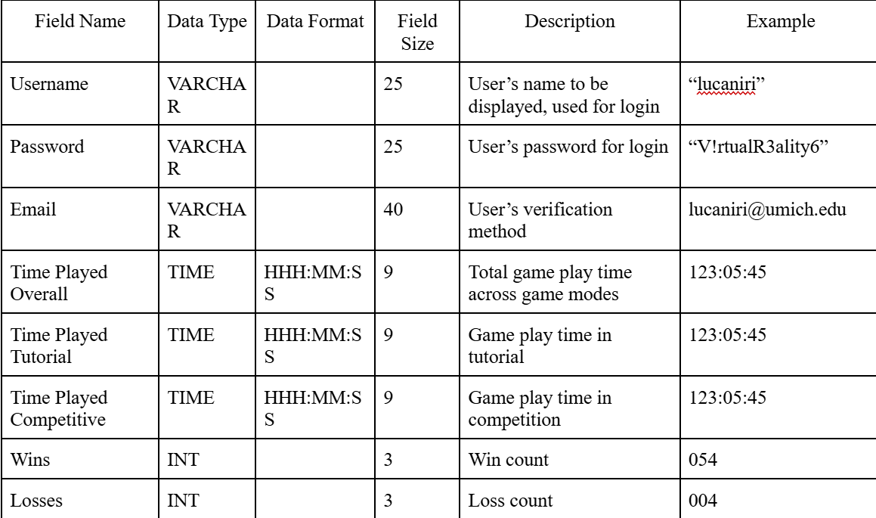
3.0 Reviews and Audits Continued
3.2.5.3 Work products produced
Review reports, updated models, and checklists.
Database schema for our database

Slide 14
3.0 Reviews and Audits Continued
3.2.6 Description of review 6 - Architectural Design Review
The sections that follow are included for each Section 3.2.6
3.2.6.1 Description and focus of the review
Purpose of the review (e.g., verify adherence to specifications, identify design flaws).
Ensure our overall system architecture is manageable and capable of supporting our project
3.2.6.2 Timing of the review
Specify when the review is conducted during the development lifecycle (e.g., after completing requirements gathering, before implementation).
Performed after requirements collection during the planning process, prior to implementation
3.2.6.3 Work products produced
Review reports, updated models, and checklists.
No report, but determined we will use Unity Game Engine with a MongoDB database, hosting the game on SteamVR.
3.2.6.4 Review checklist
A predefined list of criteria specific to the type of review (e.g., for code reviews: adherence to coding standards, absence of syntax errors).
Find a database to use
Keep database simple, no need for complex operations
Ensure Unity is compatible with database

Slide 15
3.0 Reviews and Audits Continued
3.2.7 Description of review 7 - Interface Design Review
The sections that follow are included for each Section 3.2.7
3.2.7.1 Description and focus of the review
Purpose of the review (e.g., verify adherence to specifications, identify design flaws).
Ensure that our UI interface is designed for usability, maintaining practicality and simplicity.
3.2.7.2 Timing of the review
Specify when the review is conducted during the development lifecycle (e.g., after completing requirements gathering, before implementation).
Will be completed after front end development is synthesized with back end logic.

Slide 16
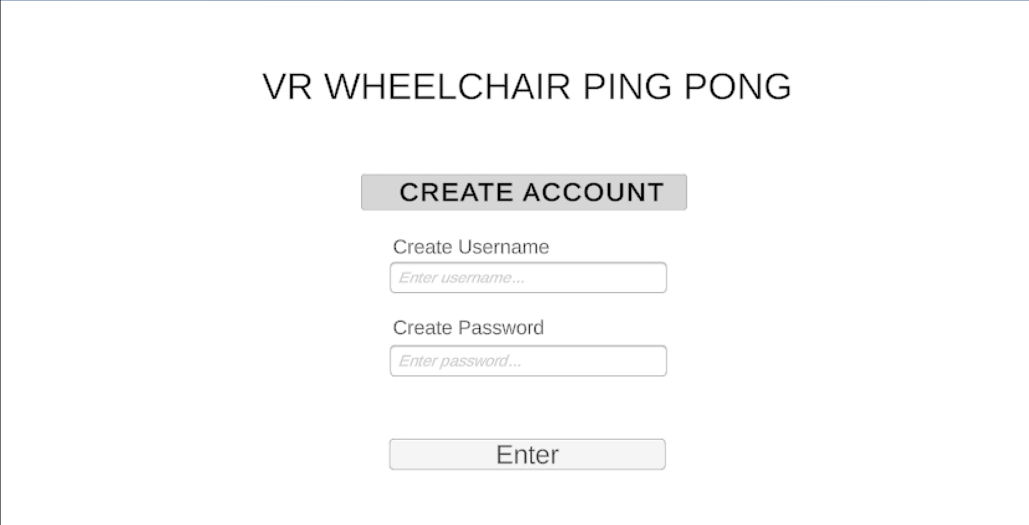
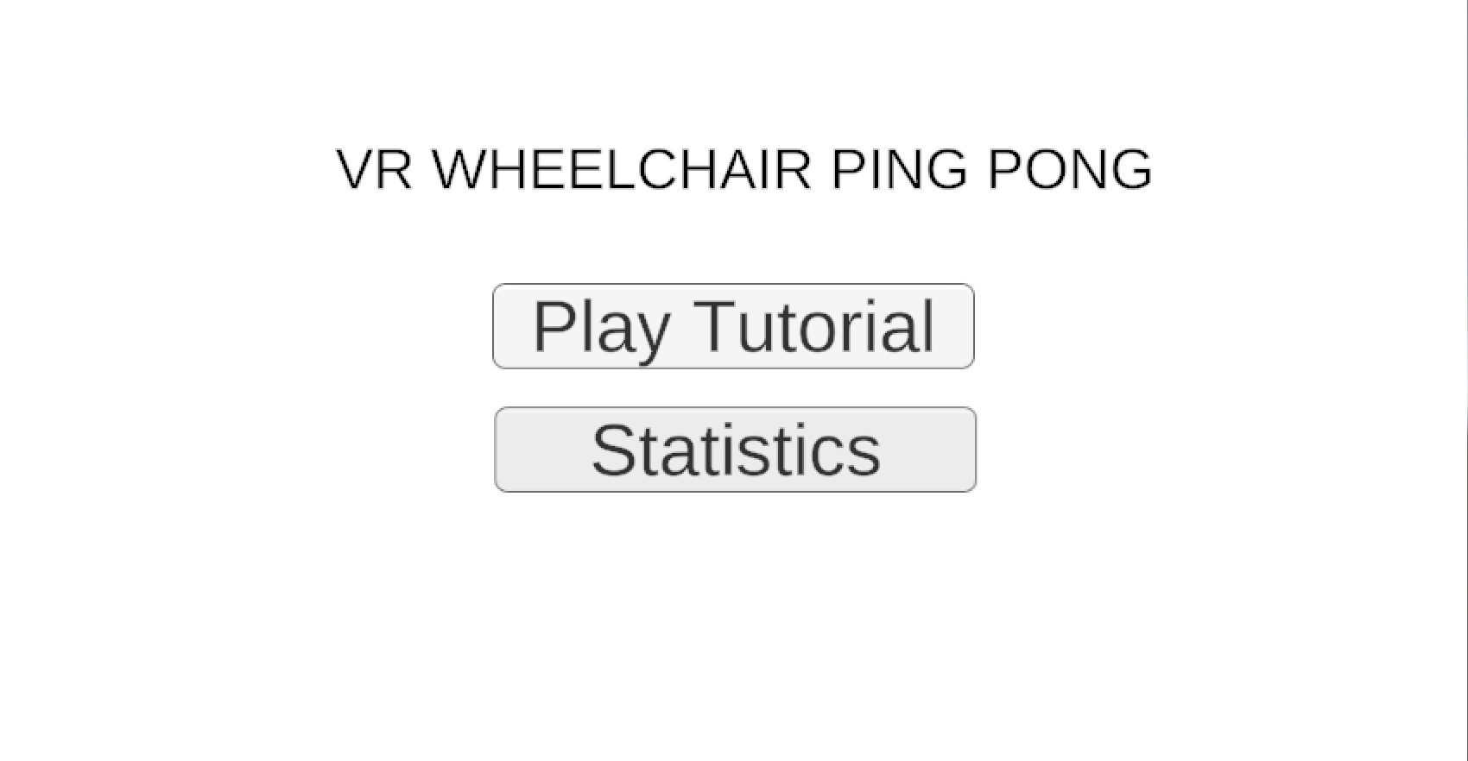
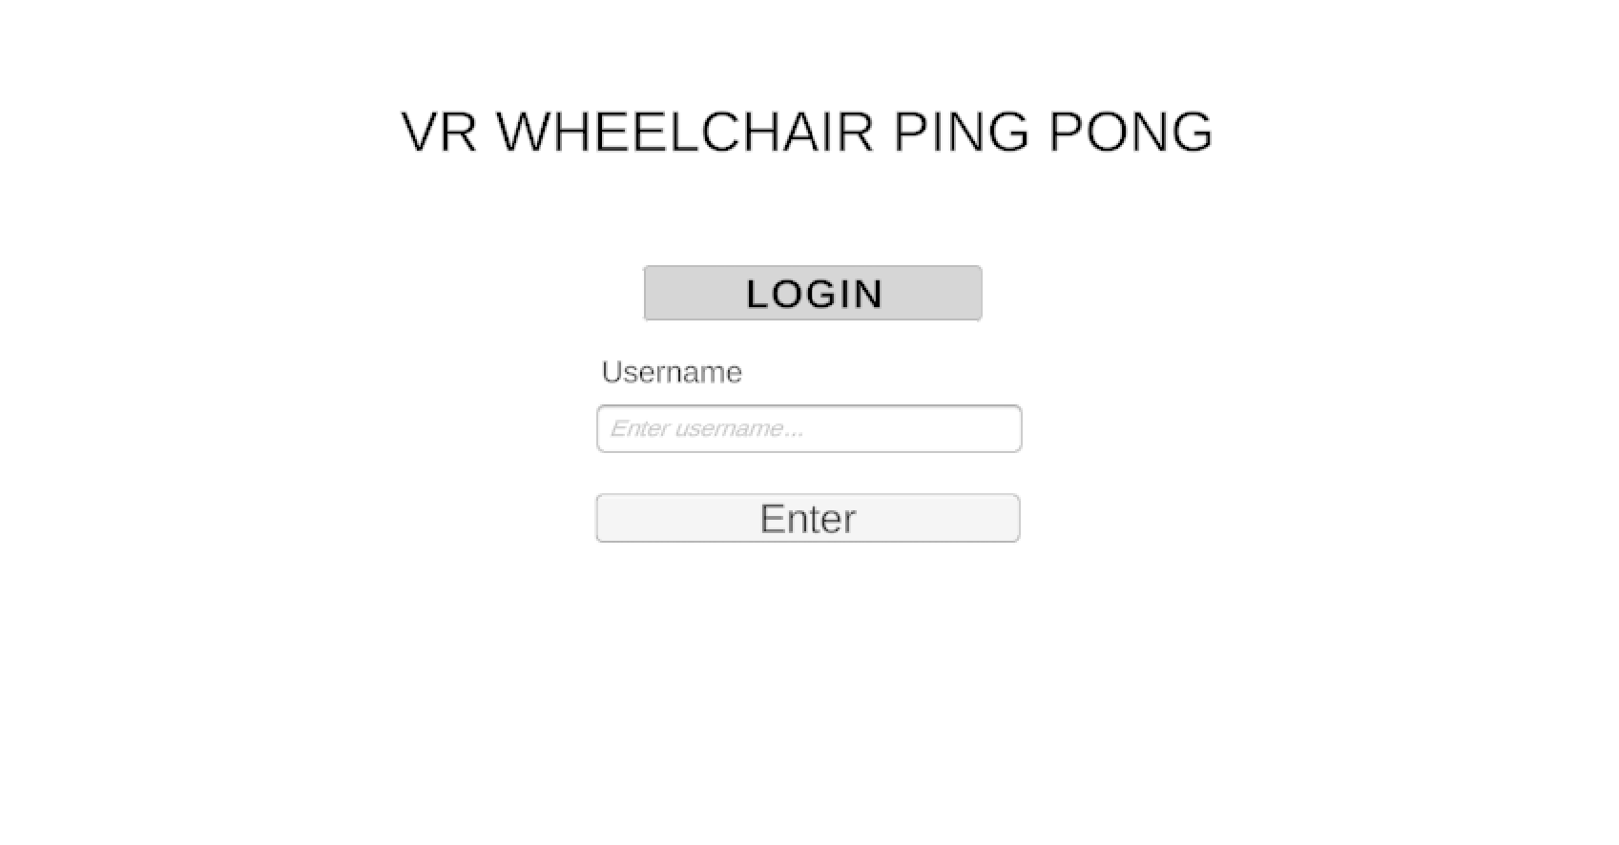
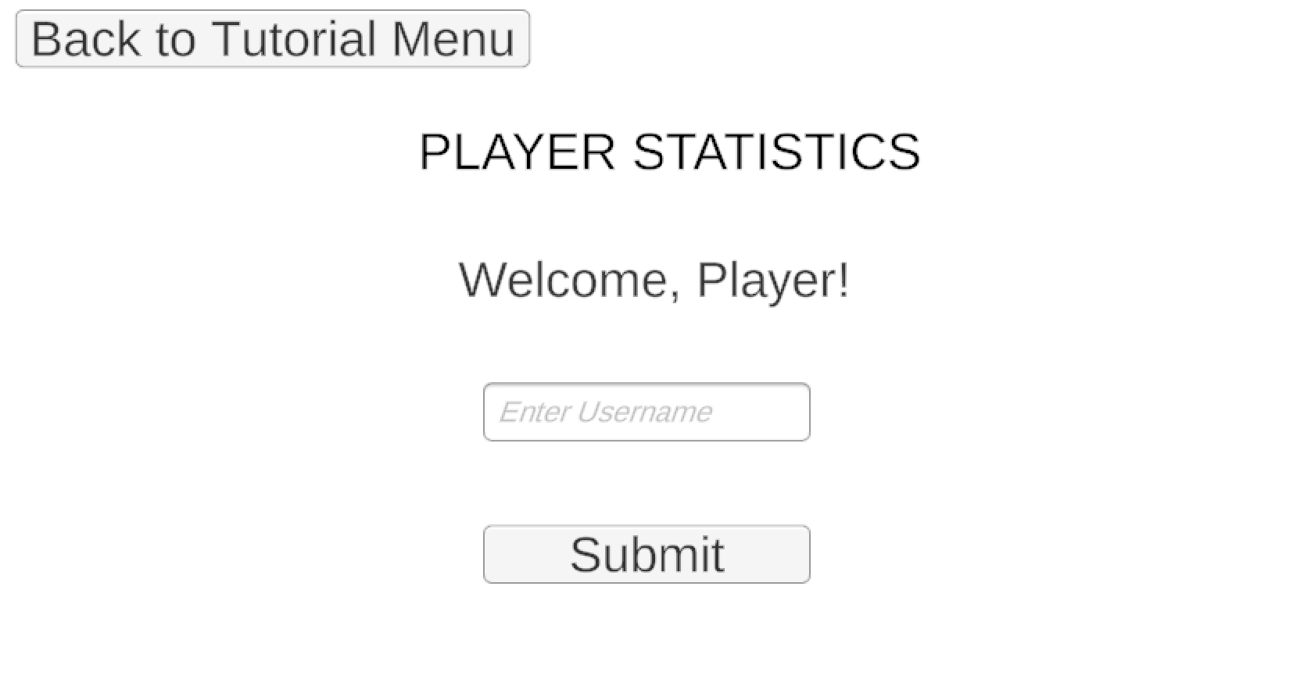
3.0 Reviews and Audits Continued
Current Model Appearance: Main Menu:
Tutorial Menu:
Statistics Menu: Login:

Slide 17
3.0 Reviews and Audits Continued
3.2.8 Description of review 8 - Component Design Review
The sections that follow are included for each Section 3.2.8
3.2.8.1 Description and focus of the review
Purpose of the review (e.g., verify adherence to specifications, identify design flaws).
Review the appearance and functionality of the game components such as the paddle, table, ball, and UI features
3.2.8.2 Timing of the review
Specify when the review is conducted during the development lifecycle (e.g., after completing requirements gathering, before implementation).
This review will be conducted throughout the development process, but a final, all-encompassing review will take place before and potentially during the testing phase before deployment.

Slide 18
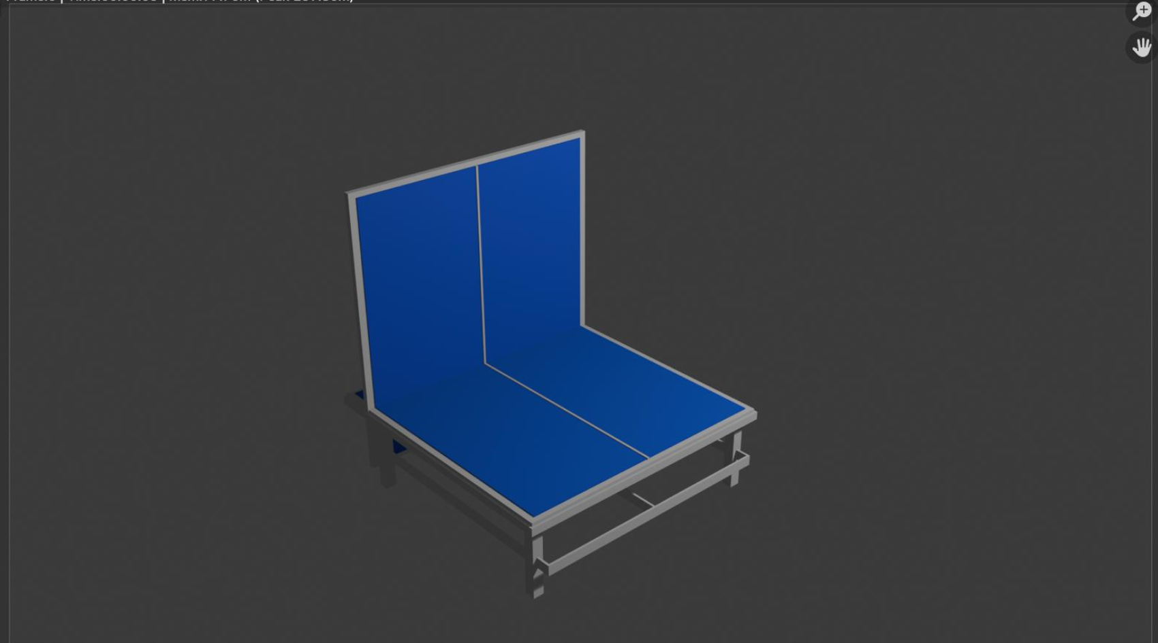
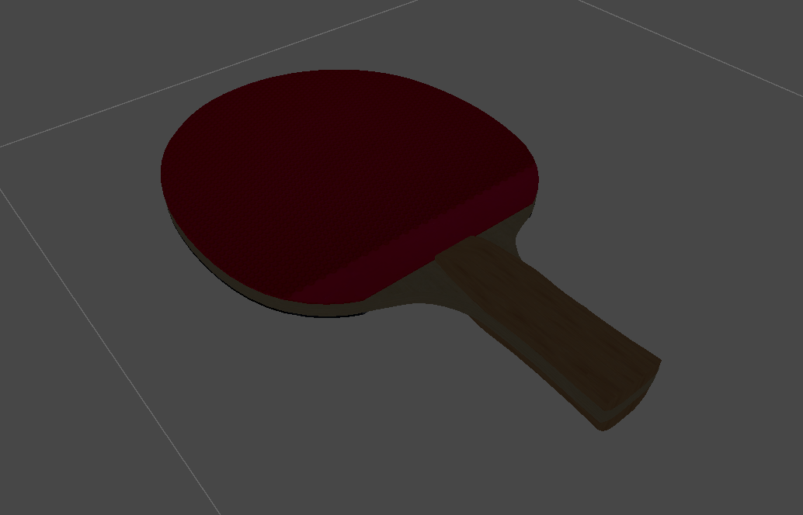
3.0 Reviews and Audits Continued
3.2.8.4 Review checklist
A predefined list of criteria specific to the type of review (e.g., for code reviews: adherence to coding standards, absence of syntax errors).
Table looks accurate and realistic
Table has accurate bounce and collision properties
Ball looks accurate and realistic
Ball has accurate bounce and collision properties
Paddle looks accurate and realistic
Paddle has accurate bounce and collision properties

Slide 19
3.0 Reviews and Audits Continued
3.2.9 Description of review 9 - Code Reviews
The sections that follow are included for each Section 3.2.9
3.2.9.1 Description and focus of the review
Purpose of the review (e.g., verify adherence to specifications, identify design flaws).
Ensure all code is functional, concise, and sticks to our standards
3.2.9.2 Timing of the review
Specify when the review is conducted during the development lifecycle (e.g., after completing requirements gathering, before implementation).
Completed as components are completed, either by individual or other team members.
3.2.9.3 Work products produced
Review reports, updated models, and checklists.
See checklist
3.2.9.4 Review checklist
A predefined list of criteria specific to the type of review (e.g., for code reviews: adherence to coding standards, absence of syntax errors).
Code required for the following:
Ball
Collision physics
Gravity setting
Ball reset
Paddle
Collision physics
Table
Collision physics
Game screens
Register screen → tutorial screen
Login screen → tutorial screen
Tutorial screen → tutorial gameplay OR statistics menu

Slide 20
3.0 Reviews and Audits Continued
3.2.10 Description of review 10 - Test Specification Review
The sections that follow are included for each Section 3.2.10
3.2.10.1 Description and focus of the review
Purpose of the review (e.g., verify adherence to specifications, identify design flaws).
Ensure test cases perform at 70% code coverage minimum.
3.2.10.2 Timing of the review
Specify when the review is conducted during the development lifecycle (e.g., after completing requirements gathering, before implementation).
Following implementation, before delivery.
3.2.10.3 Work products produced
Review reports, updated models, and checklists.
Test Plan currently in progress
3.2.10.4 Review checklist
A predefined list of criteria specific to the type of review (e.g., for code reviews: adherence to coding standards, absence of syntax errors).
Tentative Test Plan for the following
Ensure game screens all redirect user properly
Ensure user can navigate backwards through game screens
Ensure “Statistics” screen accurately displays data directly from the database
Ensure “Play Tutorial” button accurately redirects to gameplay
Ensure all gameplay elements have correct collision and gravity logic.
Ensure end-of-gameplay condition terminates gameplay when evaluated to true.

Slide 21
3.0 Reviews and Audits Continued
3.3 SQA Audits
A description of audits performed by the SQA group with the intent of assessing how well SQA and software engineering activities are being conducted on a project.
The SQA plan was audited and evaluated by the group. The focal point of the audits was directed towards aspects of the project directly affecting the prototype more so than the final deliverable. This is because it is of higher priority at this point in time. Specifically, we focused on the UI design, component design, code and test specification reviews. We determined that our SQA plan is being actively applied to our development process.

Slide 22
4.0 Problem Reporting and Corrective Action/Follow-up
4.1 Reporting mechanisms
Problems identified during reviews, audits, or testing will be logged in a centralized issue-tracking system (e.g., Hive or GitHub Issues). Each report will include:
A unique identifier for the issue.
A detailed description of the problem.
Steps to reproduce the issue (if applicable).
Severity and priority level.
Assigned team member responsible for resolution.
4.2 Responsibilities
Describes who has responsibility for corrective actions and follow-up.
Development Team: Log and verify reported problems, prioritize issues, and confirm resolutions. Address assigned issues, ensure fixes are integrated into the codebase, and conduct follow-up testing.
Project Manager: Monitor issue resolution progress, reallocate resources if necessary, and ensure adherence to deadlines.

Slide 23
4.0 Problem Reporting and Corrective Action/Follow-up Continued
4.3 Data collection and evaluation
Describes the manner in which error/defect data are collected and stored for future or real-time evaluation.
Defect Logs: Each defect is documented in the tracking system with relevant metadata (e.g., type, severity, recurrence).
Error Trends: Metrics such as defect density, resolution time, and reopened issues are analyzed to identify systemic problems.
Real-Time Monitoring: Automated testing tools generate error reports for immediate analysis.
4.4 Statistical SQA
Describes the quantitative techniques that will be applied to error/defect data in an effort to discern trends and improvement.
Defect Density Analysis: The number of defects per unit of code is calculated to assess the software's quality.
Root Cause Analysis (RCA): Patterns in defect data are analyzed to identify and eliminate common sources of errors.
Process Metrics: Performance of the QA process is measured using metrics like defect discovery rates and resolution efficiency.

Slide 24
5.0 Software Process Improvement Activities
The SQA group (and others) is often chartered with responsibility for software process improvement (SPI). This section describes the work associated with SPI.
5.1 Goal and objectives of SPI
The goal and objectives of SPI are defined.
The primary goal of Software Process Improvement (SPI) is to enhance the quality and efficiency of the development process. Objectives include:
Reducing defect rates through better practices and tools.
Streamlining testing and review processes to minimize delays.
Improving team collaboration and communication.

Slide 25
5.0 Software Process Improvement Activities Continued
Specific to the SQA group
5.1 Goal and objectives of SPI
The goal and objectives of SPI are defined.
Process Audits: Regularly assess current workflows for meeting with standards and identify areas for improvement.
Tool Optimization: Evaluate and integrate new tools to improve efficiency in debugging, testing, and project management.
Feedback Implementation: Incorporate feedback from team members and end-users to refine processes.
Continuous Monitoring: Use quantitative metrics to track progress and adjust SPI strategies as needed.

Slide 26
6.0 Software Configuration Management Overview
Version Control: GitHub Desktop is utilized for management branches and tracking changes to both the code and our Unity assets.
Branch Management: Developers create separate branches for new features or testing enhancements as to not negatively impact functional code in the main branch.
Asset Management: Unity project assets, including prefabs, scripts, and scenes, are stored within a separate “Assets” folder to prevent conflicts with anything else.
Build Automation: CI/CD pipeline configured with GitHub Actions will be configured for automatic building and testing for Unity Projects.
Change Management: All changes are documented through branch descriptions, pull requests, and team discussion before merging
SCM Tools and Resources:
i. Version Control: GitHub Desktop for local branch management and synchronization with GitHub.
ii. Branching Strategy: Feature-based branching.
iii. Collaboration: Pull requests for code review on GitHub.
iv. Issue & Timeline Tracking: Hive.

Slide 27
7.0 SQA Tools, Techniques, Methods
Tools
Testing Frameworks: Unity Test Framework for testing game mechanics and physics.
Performance Analysis: Unity Profiler for frame rate optimization and Oculus Performance Tools for VR-specific testing
Debugging: Unity’s Play Mode for real-time debugging.
VR Hardware Testing: Oculus Quest or Vive for hands-on testing of game mechanics in VR.
Techniques:
VR-Specific Testing: Evaluate motion sickness prevention, input tracking, and hand-controller interactions.
Continuous Integration (CI): Automate Unity builds and ensure testing at every stage of integration.
End-to-End Testing: Simulate real-world gameplay scenarios in VR to ensure user satisfaction.
Methods:
Physics Validation: Ensuring accurate collision and bounce properties for the paddle, ball, and wheelchair.
Formal Technical Reviews (FTRs): Conducting code, asset, and gameplay reviews for defects and improvements.
User Feedback Loops: Incorporating real user feedback to improve gameplay and usability.

Slide 28
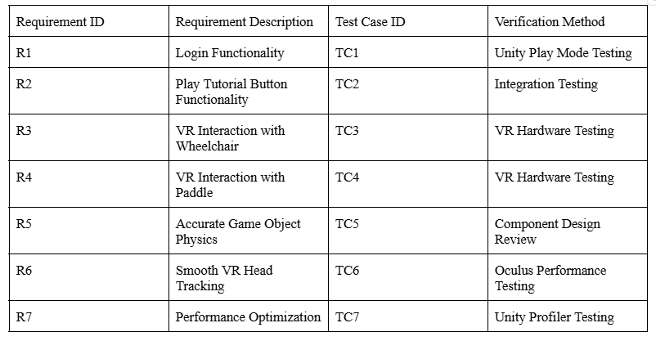
8.1 Traceability Matrix:
8.0 Appendix

Slide 29
8.2 References:
Unity Documentation: https://docs.unity3d.com
Oculus VR Performance Guidelines: https://developer.oculus.com/performance
GitHub Actions Documentation: https://docs.github.com/actions
Unity Profiler Documentation: https://docs.unity3d.com/Manual/Profiler.html
8.0 Appendix Continued

